Slide 2
Injury management for triathlon
Gareth Jones BSc MSST Dip PT

Slide 3
Phases of Healing
Inflammation
Proliferation
Remodelling
Swelling
Bruising
Pain
Weakness
24-48 hours – 3 weeks
Scar tissue
Weak & disorganised
Unable to withstand forces
Tissue starts to mature
Process can last months
Strong linear appearance
Withstand kinetic movement

Slide 4
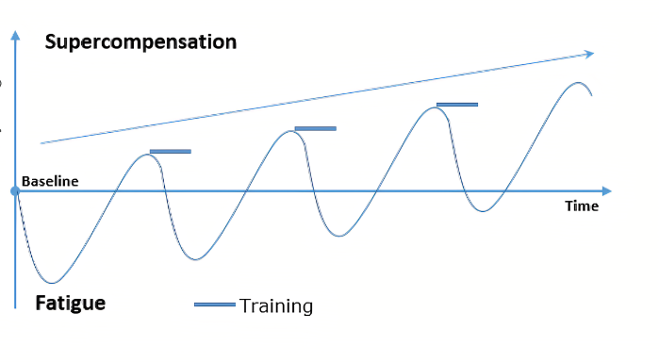
Progression – Fatigue – Injury
87% of triathletes suffered with an overuse injury within 6 months of training (Kienstra., et al 2017).

Slide 5
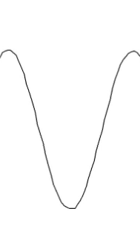
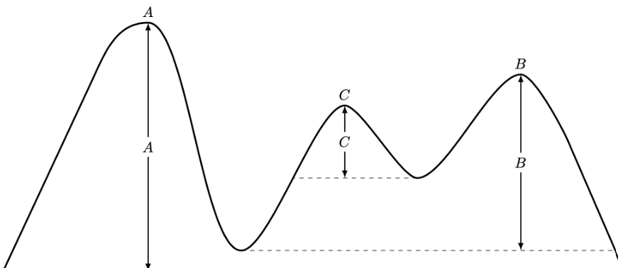
Types of pain
Inflammation
Mechanical
Neural
Erratic
and
unpredictable

Slide 6
Muscle healing timeline
Inflammation – Muscle regeneration starts approximately 4-5 days after injury
Proliferation – Peaks at 2 weeks (Pain may stop but you’re not ready)
Remodelling – Diminishes approximately 3-4 weeks
Depends on size and severity of injury
3 grades of muscle injury
Do not stretch! – Early isometric exercises

Slide 7
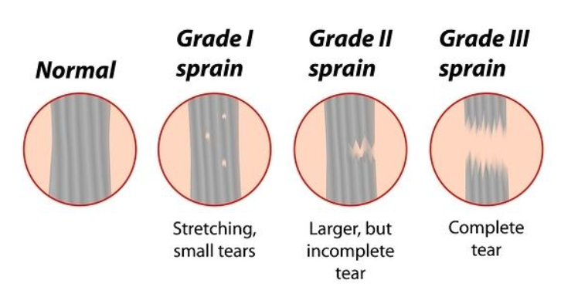
3 grades of muscle injury

Slide 8
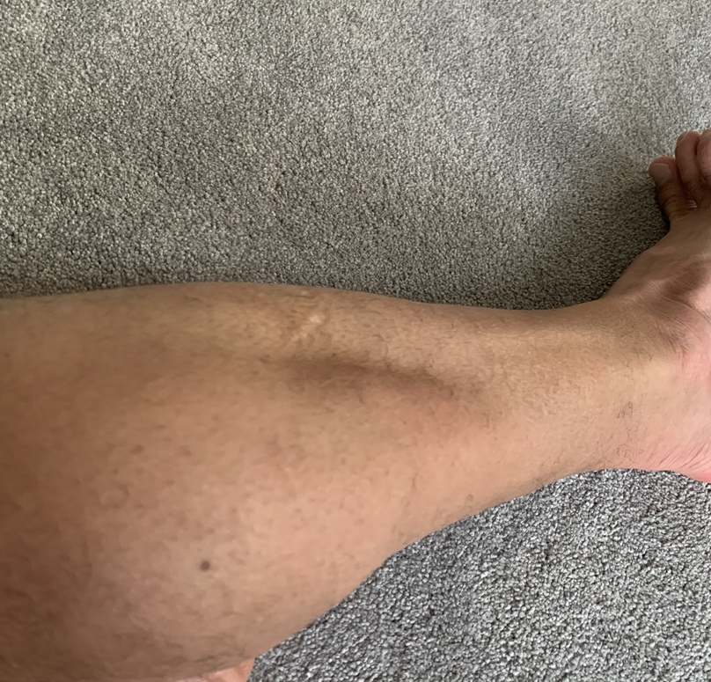
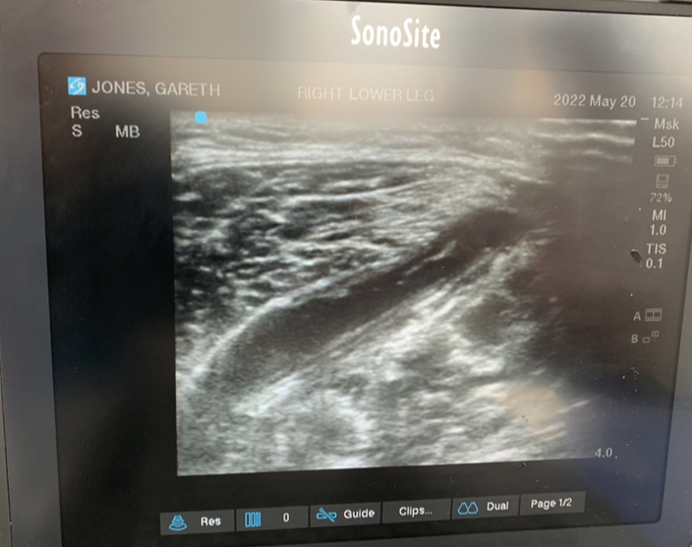

Slide 9
Tendon healing timeline
Inflammation – 0 -14 days
Proliferation – 2 – 4 weeks (Type 3 collagen)
Remodelling – From 4th to 26 weeks (Type 1 collagen)
De-Load
Strength is key if no loss of flexibility

Slide 10
Tendinopathy Continuum
Normal
Reactive
Dysrepair
Degenerative
Management
Normal Tendon
Reactive tendon
Dysrepair stage
No way back!
Your choice!
Strength
Biomechanics

Slide 11
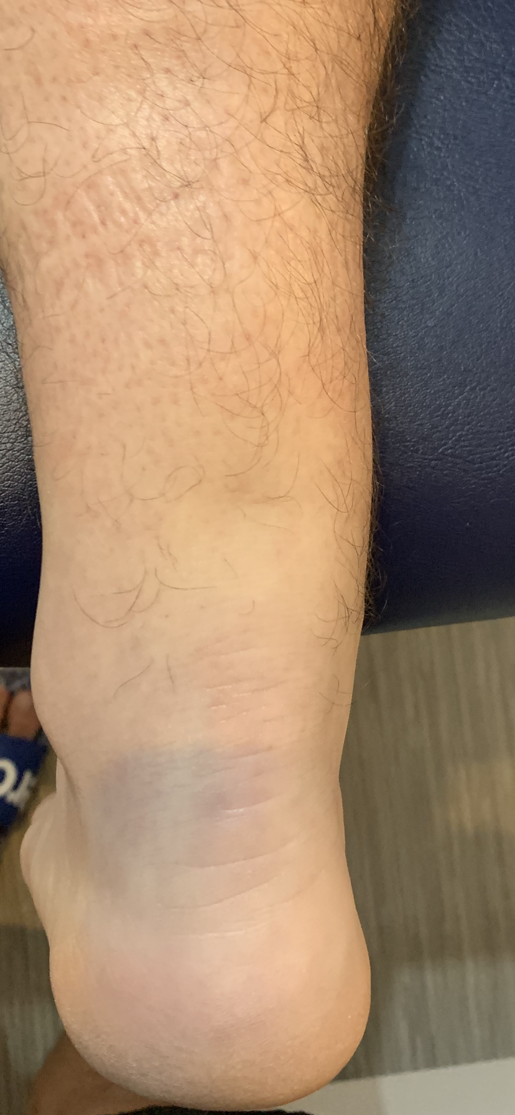

Slide 12
Factors that may affect healing time
Age – Metabolism slows which will affect the ability to heal
Previous injury – Previous injury or weakened tissue may affect healing
Metabolic influence – Blood supply (Meniscus)
Activity levels – Too much! Too little!
If in doubt hit the pool – Hydrotherapy can encourage load with little stress

Slide 13
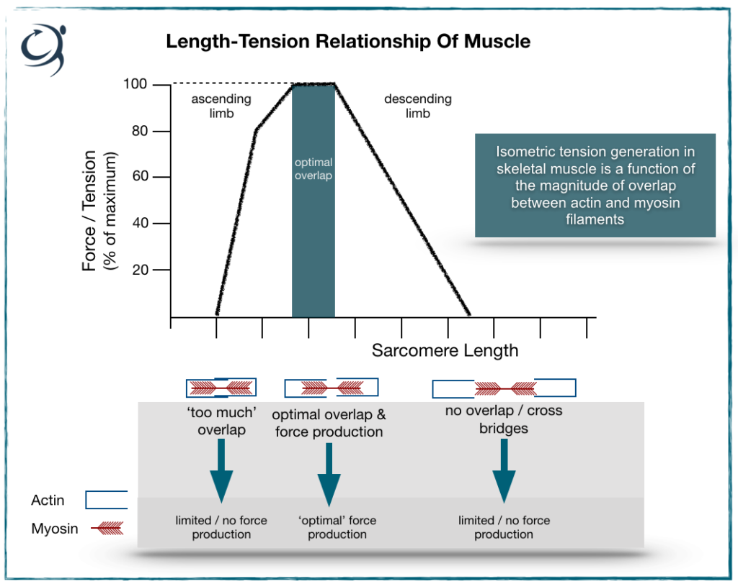
The effects of injury on performance

Slide 14
Most common Triathlon Injuries
Swimming
Cycling
Running
Shoulder impingement
Bursitis
Biceps tendonitis
Lower back pain
Anterior labrum tear
Hip & knee pain to be covered
Anterior knee pain – Quadriceps tendonitis – Patella tendinopathy – PFJS.
Lower back pain
Neck pain
Guyon’s canal syndrome
Carpal tunnel syndrome
Achilles tendinopathy
Plantar fasciitis
Shin splints – MTSS
IT band syndrome
Patella femoral joint pain
Sprains and strains
Nerve related pain

Slide 15
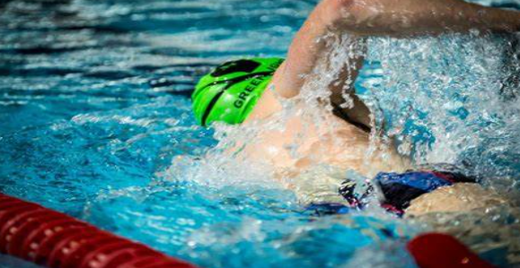
Swimming injuries

Slide 16
Injury prevention for swimming
Mobility - Shoulder – Scapula humeral rhythm!
Mobility - Cervical and thoracic spine rotation.
Stability/ Movement Control - Core
Strength - Core stability
Strength - Shoulder and Scapula stabilisers and lats/ pecs (Pull)
Strength - Hip and knee flexors and extensors (Kick)

Slide 17
Shoulder impingement
Biomechanics – Scapula humeral rhythm!
How to self diagnose – Empty can test (Apply downward force and resist)
What to avoid – Movements above the head
Self treatment – Isometrics and pendulum exercises
When to seek help – Chronic pain (3 weeks plus) May lead to further damage

Slide 18
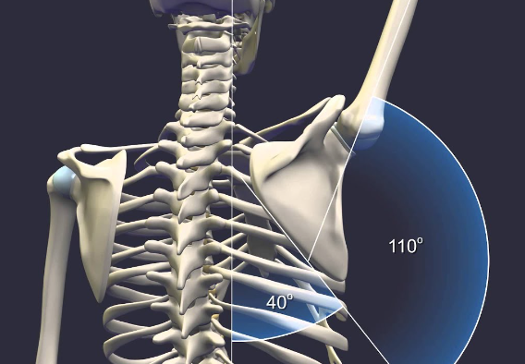
Scapular humeral rhythm

Slide 19
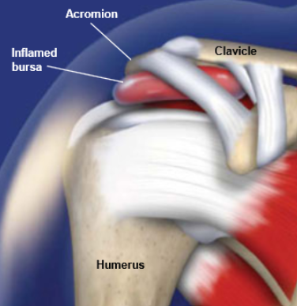
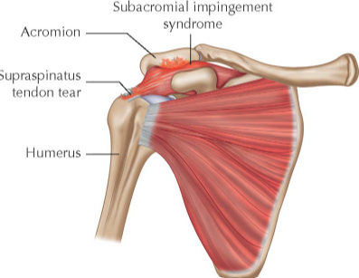
Two types of impingement

Slide 20
Biceps tendonitis
Biomechanics – Pulley system!
How to self diagnose – Speeds test and palpation of the bicipital groove
What to avoid – Heavy lifting and rapid arm movement
Self treatment – Ice and isometrics (6 x 10 seconds holds for cortical inhibition)
When to seek help – If the pain gets worse – May lead to labrum tear!

Slide 21
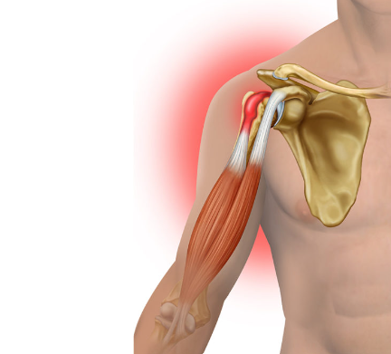
Biceps tendonitis

Slide 22
Other injuries to consider
Lower back pain – Hyperextension or excessive hip movement (SIJ!)
Hip pain
Anterior labrum tear (MRI) – Test with hip flexion/ Adduction
Knee pain – Possibly bursitis – Beware of bakers cyst forming over time

Slide 23
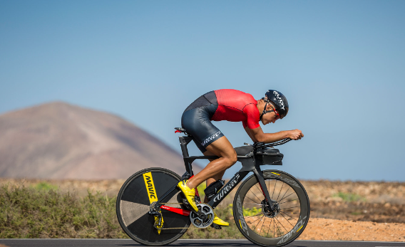
Cycling injuries

Slide 24
Anterior knee pain
The three main players – Quadricep tendonitis – Patella tendinopathy – PFJS
How to self diagnose – Position of pain will give it away
What to avoid – Heavy power sets
Self treatment – Single leg exercises and ice
When to seek help – Chronic pain (3 weeks plus)
Bike position can play a part in anterior knee pain! Low and forward

Slide 25
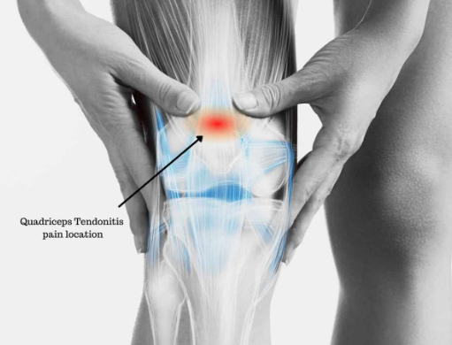
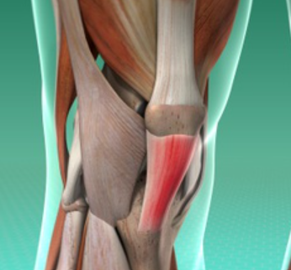
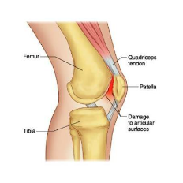

Slide 26
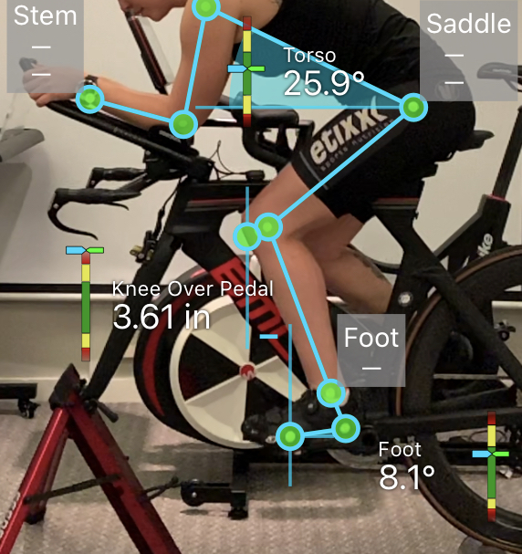

Slide 27
Guyon’s canal syndrome
How to self diagnose – Numbness in certain fingers
What to avoid – Compression
Self treatment – Stretch
When to seek help – Chronic numbness
Bike position – Be aware of ulna/Radial deviation

Slide 28
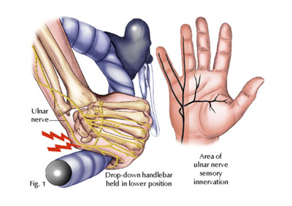

Slide 29
Carpal tunnel syndrome
How to self diagnose – Numbness in certain fingers
What to avoid – Compression
Self treatment – Stretch
When to seek help – Chronic numbness
Bike position – Be aware of ulna/Radial deviation

Slide 30
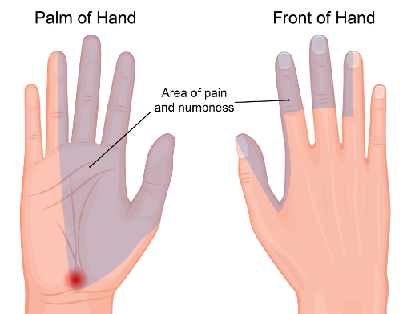

Slide 31
Lower back and neck pain
How to self diagnose – What type of pain is it? Mechanical vs Inflammation!
What to avoid – Will depend on the diagnosis
Self treatment – Back stretcher and sleeping position
When to seek help – Always seek help for back and neck
Bike position and sizing!

Slide 32
Running injuries

Slide 33
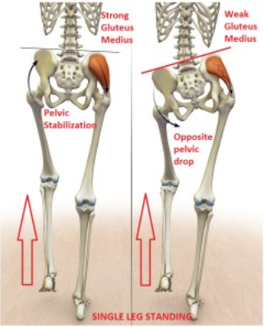
Gluteus Medius Dysfunction

Slide 34
Achilles tendinopathy
Biomechanics – Kinematics – Over-pronation and torsional forces
How to self diagnose – Palpation – Position
What to avoid – Closed kinetic chain – Running – Jumping
Self treatment – Ice and strength (De-Load)
When to seek help – Always – Consider shockwave therapy
Continuum!

Slide 35
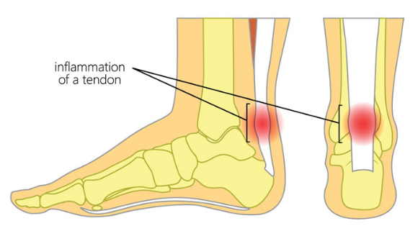
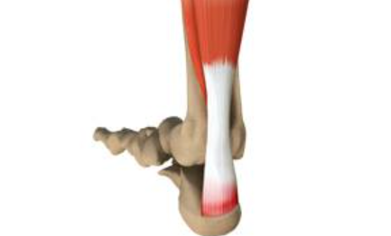
Achilles tendinopathy
Mid portion Insertional

Slide 37
Achilles Rupture

Slide 38
Plantar Fasciitis
Biomechanics – Windlass mechanism
How to self diagnose – Palpation
What to avoid – Excessive loading
Self treatment – Ice and lacrosse ball
When to seek help – Shockwave 9/10

Slide 39
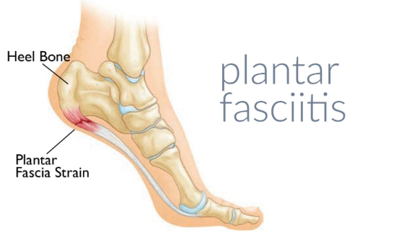
Plantar Fasciitis

Slide 40
Shin splints
Biomechanics – Torsional forces! Check shoes
How to self diagnose – Palpation
What to avoid – Impact
Self treatment – Ice and compression
When to seek help – Chronic pain – May be stress fracture

Slide 41
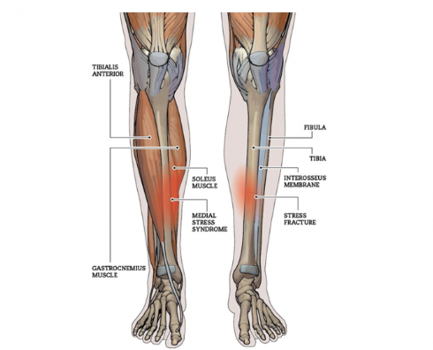
Shin splints

Slide 42
ITB Syndrome
Biomechanics – Internal hip rotation
How to self diagnose – Point of pain
What to avoid – Uneven ground and long runs
Self treatment – Self massage (TFL)
When to seek help – If it stops you running

Slide 43
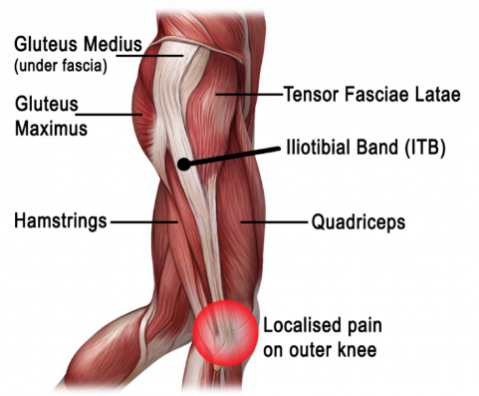
ITB syndrome

Slide 44
Patella femoral joint pain
Biomechanics – Valgus knee forces (Females at more risk)
How to self diagnose – Patella test
What to avoid – High mileage
Self treatment – Strengthen VMO (Isometrics)
When to seek help – If pain when running

Slide 45
Patella femoral joint pain

Slide 46
Sprains and strains
Biomechanics – Nerve related? Trigger points?
How to self diagnose – Strength may indicate severity
What to avoid – Stretching
Self treatment – Ice and rest (Isometrics)
When to seek help – Bruising or weakness

Slide 47
Prevention tool box
Scapula mobility drills
Core strength – Plank and rotational plank
Side plank Abduction
Single leg squats
VMO (Single leg)
Bike fit!

Slide 48
Thank you

